Slide 1
Navigating the Medicare
Plan Finder
September 2017
Notes:
This presentation highlights key features of the Medicare Plan Finder. This tool provides important cost and coverage information to help people with Medicare make an informed choice about their Medicare health and drug plan options.
This training module was developed and approved by the Centers for Medicare & Medicaid Services (CMS), the federal agency that administers Medicare, Medicaid, the Children’s Health Insurance Program (CHIP), and the Federally-facilitated Health Insurance Marketplace. The information in this module was correct as of September 2017.
To check for an updated version of this training module, visit CMS.gov/Outreach-and-Education/Training/CMSNationalTrainingProgram/Training-Library.html.
The CMS National Training Program provides this as an informational resource for our partners. It’s not a legal document or intended for press purposes. The press can contact the CMS Press Office at press@cms.hhs.gov. Official Medicare Program legal guidance is contained in the relevant statutes, regulations, and rulings.

Slide 2
What is the Medicare Plan Finder?
Web tool on Medicare.gov that lets you
  View and compare the health and drug coverage options in your area
  Identify which plans cover your prescriptions at the most affordable price where you shop
  Enroll in a Medicare Prescription Drug Plan (Part D) or a Medicare Advantage Plan (Part C)
Notes:
The Medicare Plan Finder is designed to help people view and compare the Medicare health and drug plans available in their area. It helps identify which plans cover their prescriptions at their pharmacy, at the most affordable price. The information on costs is an estimate. They can share this information with their doctor or pharmacist to discuss what works best for them.

Slide 3
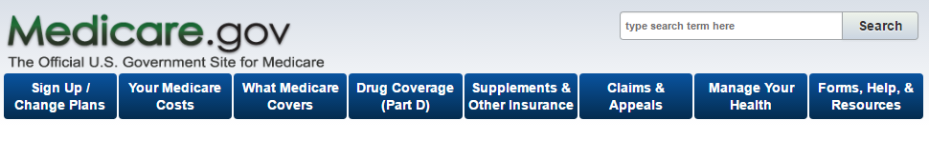
Medicare Open Enrollment
Begins October 15
  Preview next plan year’s data starting October 1
  Medicare Plan Finder will display current year and next year’s plan data
NOTE: The current year data will continue to display until November 30 for those applying for coverage for the current year.
Notes:
Medicare Open Enrollment begins October 15. You can begin to preview the next plan year’s data starting October 1. During this time, the Medicare Plan Finder will display both current year and the next year’s plan data. The current plan year data will continue to display until November 30 for those applying for coverage for the current year.

Slide 4
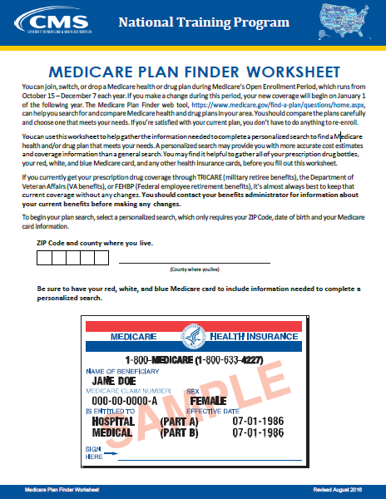
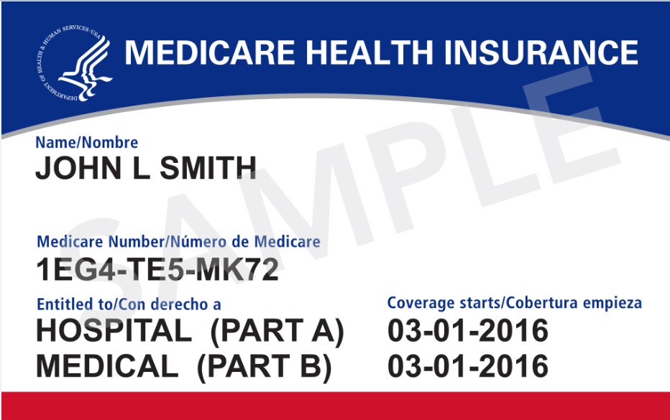
Getting Started: What You’ll Need to Help
ZIP Code
Medicare card
List of prescriptions
  Strength and quantity
  Use of generics
Pharmacy that’s used
Other health insurance cards
Subsidy eligibility
Medicaid, Low Income Subsidy letters
Notes:
It’s important to make sure that the people you counsel come prepared with the information needed to complete a plan search. This preparation will ensure they get the best estimate of how much their prescription drugs will cost where they shop. They should have the following:
ZIP Code
Medicare card
List of prescriptions
Strength and quantity
Use of generics
Pharmacy that’s used
Other health insurance cards
Subsidy eligibility
Medicaid, Low Income Subsidy letters
You can find the Medicare Plan Finder Worksheet to help you prepare in the CMS National Training Program’s Training Library at CMS.gov/Outreach-and-Education/Training/CMSNationalTrainingProgram/Downloads/Medicare-Plan-Finder-Worksheet.pdf.

Slide 5
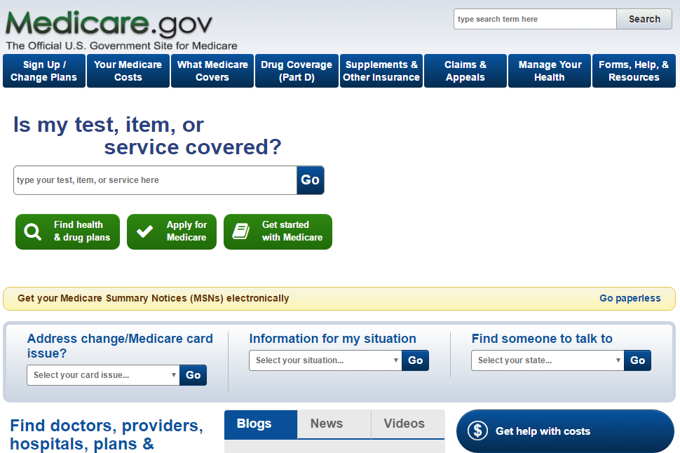
Medicare.gov Homepage
Notes:
To access the Medicare Plan Finder, click on “Find health & drug plans” on the Medicare.gov homepage. You can also click on the tab “Sign Up/Change Plans” and select “Find health & drug plans” from the drop-down menu. You can also visit Medicare.gov/find-a-plan.

Slide 6
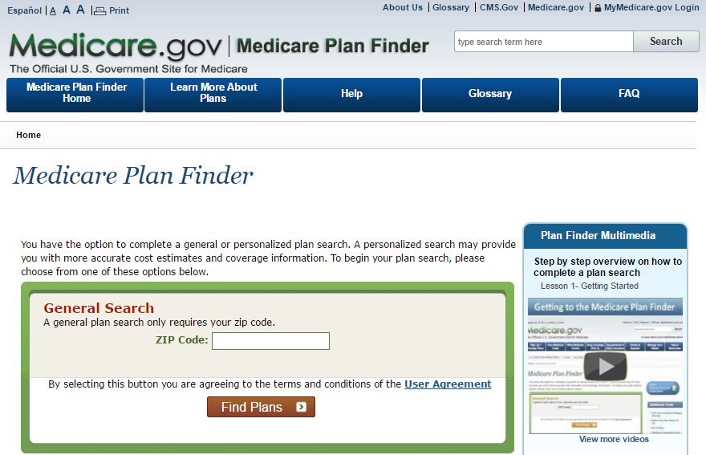
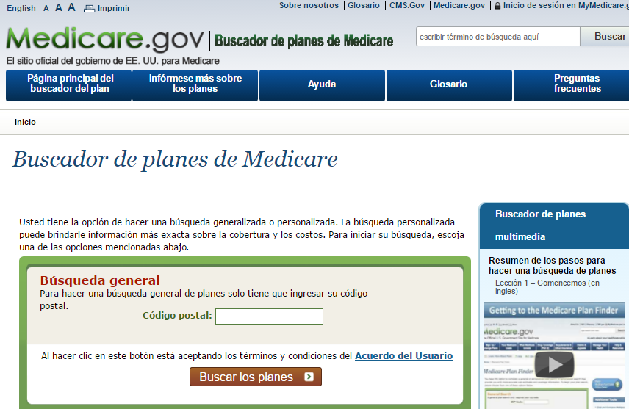
Plan Finder Spanish Version
Notes:
The Medicare Plan Finder is also available in Spanish.
To access the Spanish version, click on “Español” in the top left corner above Medicare.gov. The Spanish version will provide equivalent translations of all search results, costs, and comparisons.

Slide 7
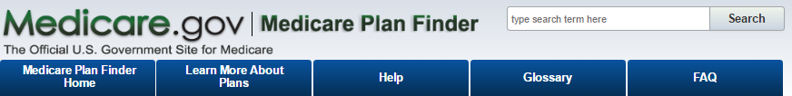
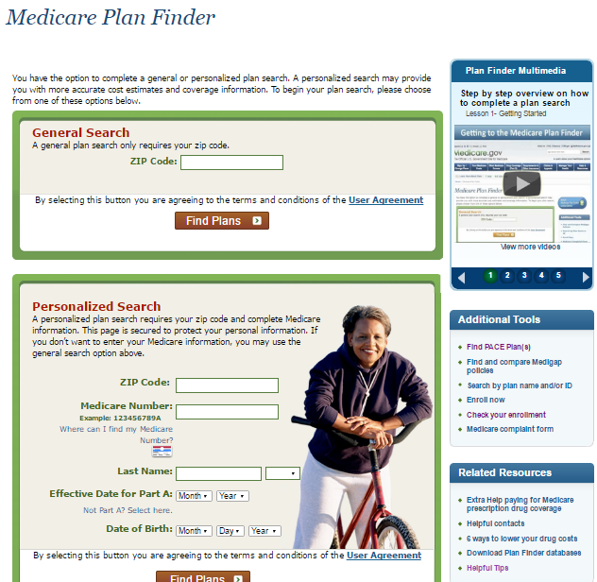
Plan Finder Homepage
Notes:
Before we begin our plan search, there are important features on the Medicare Plan Finder homepage to point out.
The Frequently Asked Questions (FAQs) are located on a top navigation button. These FAQs were generated from State Health Insurance Assistance Program (SHIP) counselors and volunteers. Here you’ll find a series of questions that come up often, ranging from “Why can’t I find my drug listed?” to “What’s the difference between a Network Pharmacy and Preferred Network Pharmacy?”
The Additional Tools listed are an extension of the Plan Finder, and allow you to “Find PACE plan(s),” “Search by plan name or ID,” “Enroll now,” “Find and compare Medigap policies,” and “Check your enrollment”- which is helpful when you want to see the status of a recent enrollment, even if the enrollment application wasn’t completed through the Medicare Plan Finder.
The Helpful Tips located in the Related Resources section of the homepage offer help items that are organized by their respective page locations on the tool with expand/collapse items for each section. This is helpful in keeping the page shorter and easier to read.

Slide 8
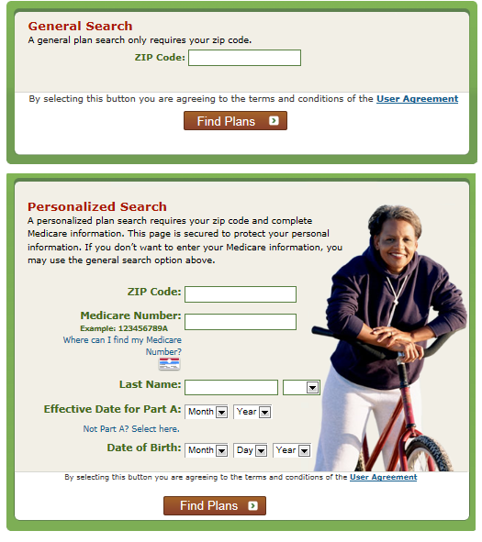
Plan Finder Search Options
Notes:
The Medicare Plan Finder offers 2 types of search options: a general search and a personalized search.
A personalized search may provide more accurate cost estimates and coverage information than a general search. The information on someone’s red, white, and blue Medicare card, along with their ZIP Code, will allow them to begin a personalized search. A personalized search will show the person’s existing coverage, any low income subsidy if applicable, and their drug list if one exists.
NOTE: The ZIP Code used in the personalized search must be the ZIP Code they have on record with Social Security. If they’ve moved recently or haven’t communicated their move to SSA, this may return an error in their personalized search.

Slide 9
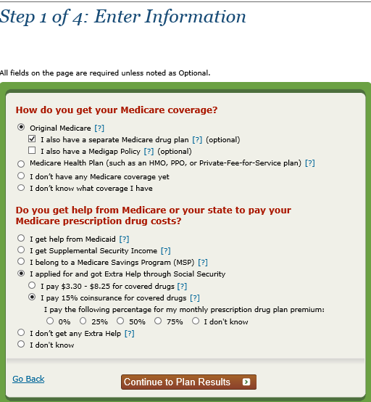
Step 1 of 4: General Search Only
The Low Income Subsidy Notice states what percentage the person with Medicare is expected to pay for their premium.
Notes:
If you choose a general search option, you’ll be asked to include certain information to better understand the person with Medicare’s specific situation. This information will help provide the best cost estimate based on their current coverage and any low income subsidy (also called Extra Help) they may get.
Important: If you’re working with someone who has both Medicare and Medicaid, it’s best to use a personalized search to more accurately reflect their monthly premiums, deductibles, costs for generic/brand name drugs, and catastrophic coverage. There are different levels of help associated with Medicaid and the Low Income Subsidy (LIS), and a general search only reflects Level 1, which is when someone has full Medicaid and an income greater than 100% of the Federal Poverty Level (FPL). In 2017 these individuals pay $0 for monthly plan premium, $0 deductible, $3.30 for generic/preferred drugs, $8.25 brand-name drugs, and $0 during catastrophic coverage.
If you’re working with someone with an income less than 100% FPL (Level 2), or working with someone living in an institution, such as a nursing home (Level 3), you won’t see the correct amount (2017) of $1.20 generic/$3.70 brand-name drugs displayed in Plan Results with a general search.
People who get:
Supplemental Security Income pay $0 for monthly premium, $0 deductible, $3.30 generic/preferred drugs, $8.25 brand-name drugs, and $0 during catastrophic coverage.
Medicare Savings Program (QMB, SLMB, QI) get help paying their Medicare Part B premium, and pay $0 for monthly premium, $0 deductible, $3.30 generic/preferred drugs, $8.25 brand-name drugs, and $0 during catastrophic coverage.
When working with people who get Extra Help paying for their prescription drugs, keep in mind that their LIS Notice states what percentage they’re expected to pay for their premium, not what Medicare pays.

Slide 10
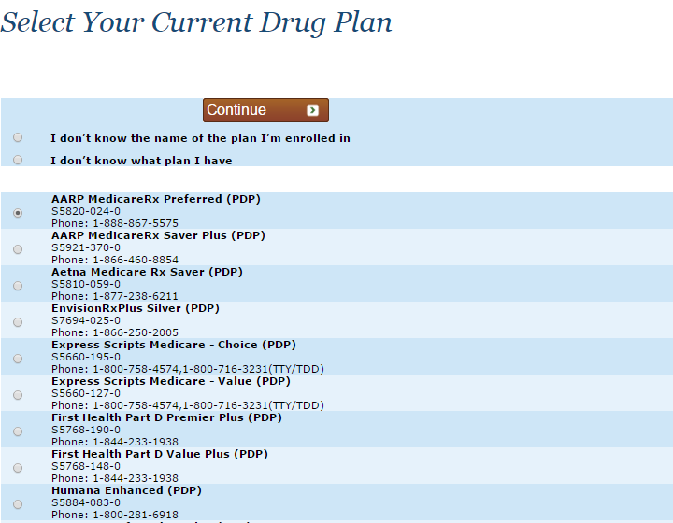
General Search Only─Select Your Current Drug Plan
Select current plan from a list of plans in your area.
Notes:
In a general search, you select someone’s current coverage from a list of plans available in their ZIP Code.
NOTE: This information is prepopulated in the Current Profile box when using a personalized search.

Slide 11
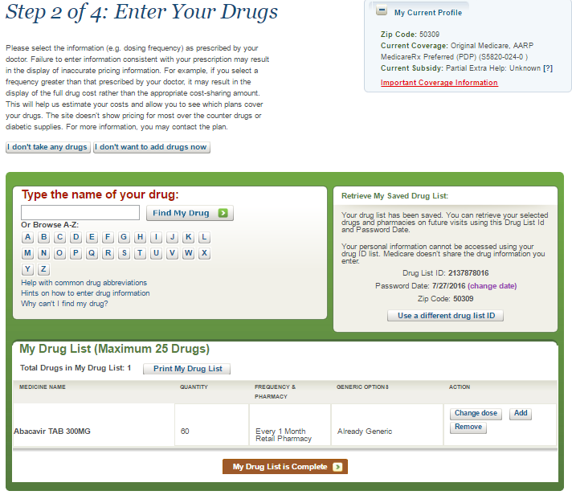
Step 2 of 4: Enter Your Drugs
Notes:
Step 2 of 4: Enter Your Drugs
NOTE: The My Current Profile section includes the ZIP Code and the information entered in the general search. This information would prepopulate with the person’s information when using a personalized search. It would include both current and future coverage with effective dates, along with any current and future subsidy information with effective dates.
There are 2 options available when you don’t want to enter drugs. It’s important to understand the cost estimates you’ll see later in the Plan Results.
If you select “I don’t take any drugs,” the amount you see later in the Plan Results will only include the annual costs for the plan’s premium if applicable.
If you select “I don’t want to add drugs now,” the Plan Finder logic assumes the person takes drugs, so the amount you see later in the Plan Results page will be an estimate of what a person might pay on average based on their health status. The default is good health, but you can change it with filter options to poor or excellent health, to update cost estimates.
When helping someone who takes prescriptions, it’s important to enter the drugs as they’re prescribed today by their doctor to get the most accurate pricing of what they’ll pay for their prescriptions.
NOTE: Blue lettering throughout the Medicare Plan Finder means you can click there for more information.

Slide 12
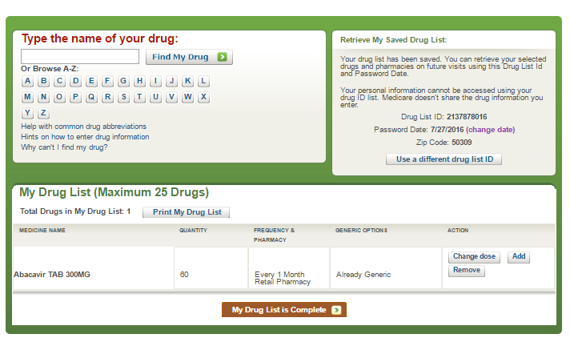
Entering Drugs
Notes:
You can retrieve someone’s existing drug list by entering the 10-digit Drug List ID and password in the Retrieve My Saved Drug List section and click “Retrieve My Drug List.” Or, begin a new drug list by typing the name of the drug and click “Find My Drug.”
When doing an update to a previous enrollment, you should double check the status of any drugs formerly listed. The old drug list may have some mail order drugs and some retail drugs, and the current plan being viewed may not offer mail order pricing. Plan sponsors, not CMS, decide which drugs to offer as mail order drugs. This varies from plan to plan and changes from year to year.
NOTE: A personalized search will go directly to Step 2 from the homepage and display the person’s drug list, if one exists.

Slide 13
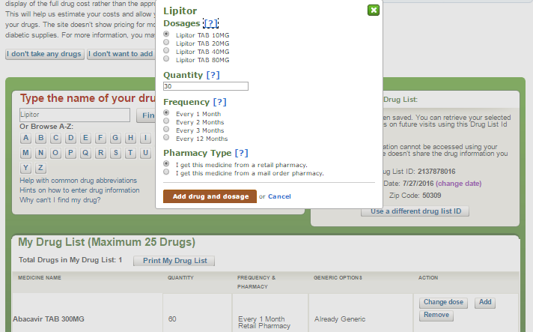
Pop-up Box to Indicate Dosage, Quantity, Frequency and Where You Buy
IMPORTANT TO ENTER AS PRESCRIBED
Notes:
Once you enter a drug, a pop-up box displays the dosage, quantity, frequency in which the person refills, and where they buy their prescription (either retail or mail order). Remember to enter the drug as it’s prescribed to display accurate pricing. For example, if you select a frequency greater than that prescribed by the doctor, it may result in the display for full drug costs, rather than the appropriate cost-sharing amount. There are additional helpful links listed below the drug entry field that include “Help with common drug abbreviations” and “Hints on how to enter drug information.”

Slide 14
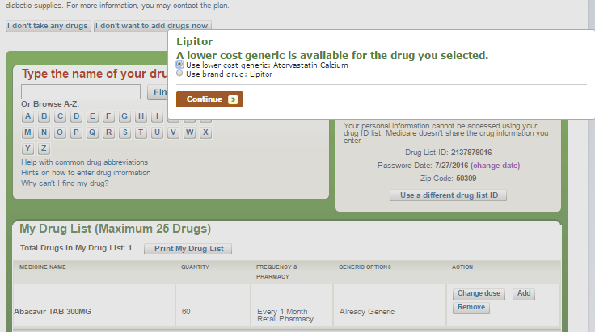
Lower Cost Generic Option
Notes:
Some brand-name drugs have a lower-cost generic alternative. The pop-up box defaults to the suggested lower-cost generic alternative. Always check with the person you’re helping to see if they want to look at pricing for the generic drug, or use the brand-name drug. They should consult their doctor or pharmacist to see what’s best for them.

Slide 15
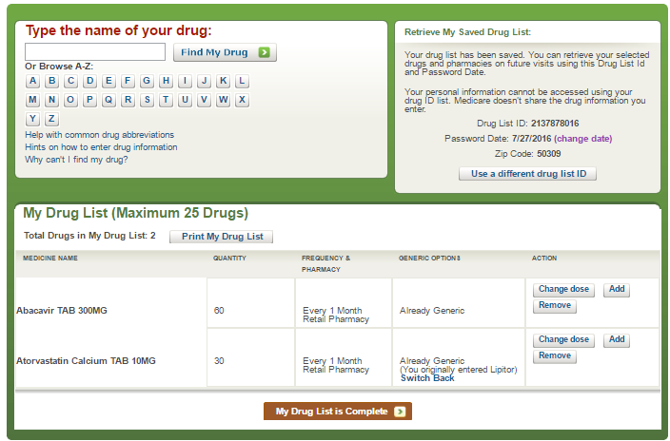
My Drug List
Notes:
With the first drug entry, you’ll note a drug list ID is generated and immediately populated with the current date as the “Password Date.”

Slide 16
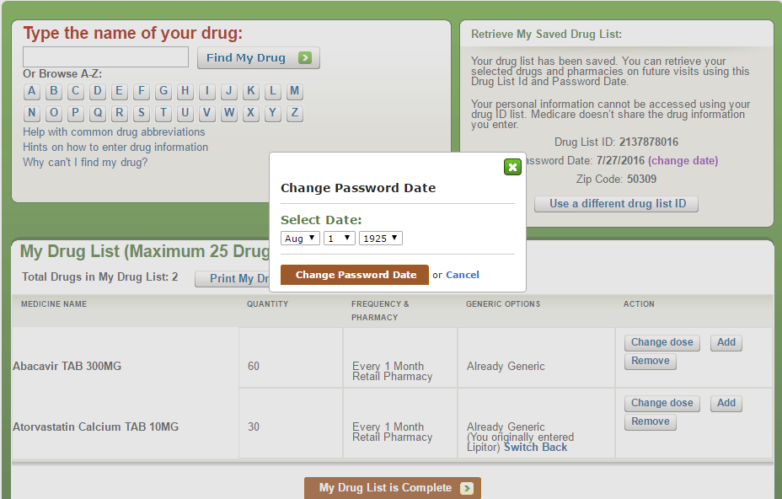
My Drug List continued
Notes:
You can change the Password Date to whatever date is easiest for the person to remember. For example, their birthday or anniversary. The drug entered will display in the My Drug List section along with the quantity, frequency, and pharmacy you selected. You can switch back to brand or generic drug, and also have the option to make changes in the ACTION column (for example, change dose, or add another dose of existing drug).

Slide 17
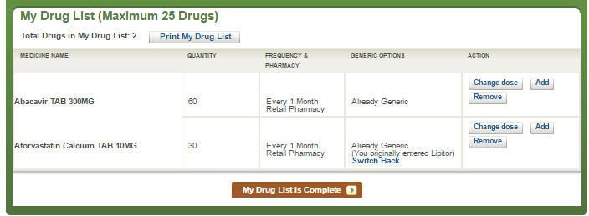
Print Drug List
Click when ready for next STEP
Notes:
Once you finish entering the drugs (maximum of 25), you can print the person’s drug list and click on “My Drug List is Complete,” to move to the next step.

Slide 18
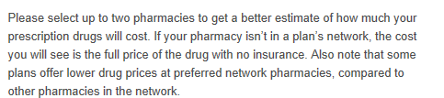
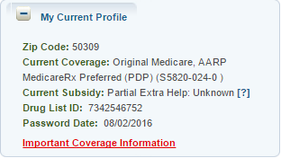
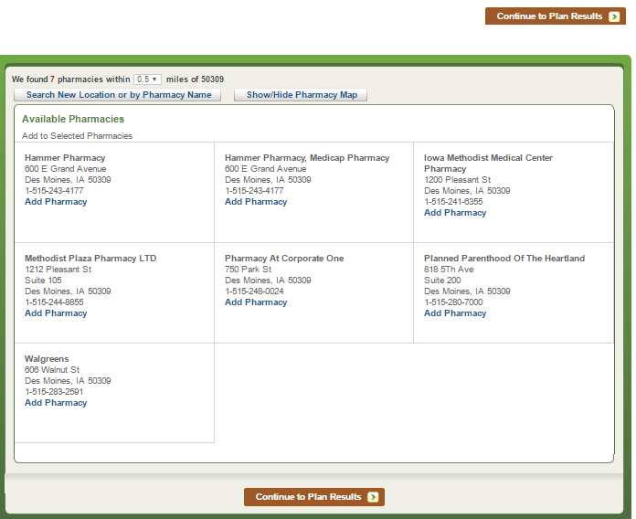
Step 3 of 4: Select a Pharmacy
Notes:
Step 3 of 4: Select your Pharmacy(ies).
The My Current Profile section at the top right now lists the Drug List ID and the Password Date. You can select up to 2 pharmacies to get a better estimate of how much the person’s prescriptions will cost by plan, based on what they negotiate with the pharmacy. Select the pharmacy where the person currently buys or shops for their prescriptions to determine whether their pharmacy is in a plan’s network (standard cost-sharing), considered a preferred pharmacy (offers preferred cost-sharing), or out-of-network (displays full price of the drugs with no insurance).
You can use the drop‐down arrow to expand the radius within the ZIP Code entered, or you can use the Search New Location or by Pharmacy Name to look for long-term care pharmacies or change the ZIP Code where they shop.
Let’s assume for this example that the person lives in ZIP Code 50309, but shops at a pharmacy in ZIP Code 50308. We’ll use the Search New Location feature and enter “50308.” Again, we can expand the 1 mile radius with the drop down, but the person currently shops at the Walgreens and Hammer Pharmacy in Des Moines.

Slide 19
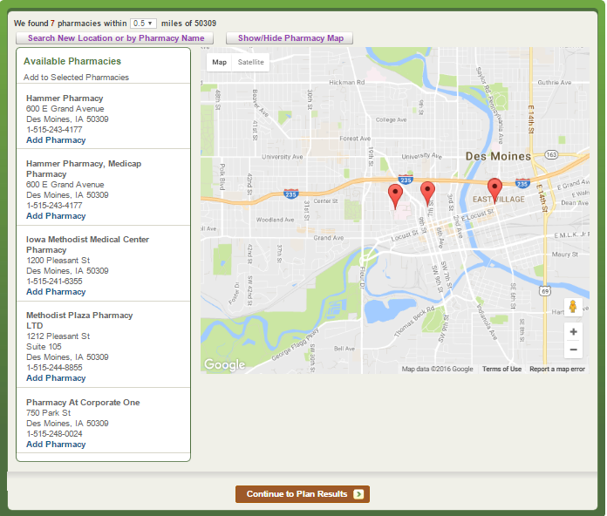
Select Up to 2 Pharmacies and View Map
Notes:
You can click on the “Show/Hide Pharmacy Map” link to show the Google Map display of all the pharmacies found in the 1 mile radius of the ZIP Code entered. You can click on “Show/Hide Pharmacy Map” again to hide the map. Next, click on the “Continue To Plan Results” button to continue in Plan Finder once the desired pharmacies have been selected.

Slide 20
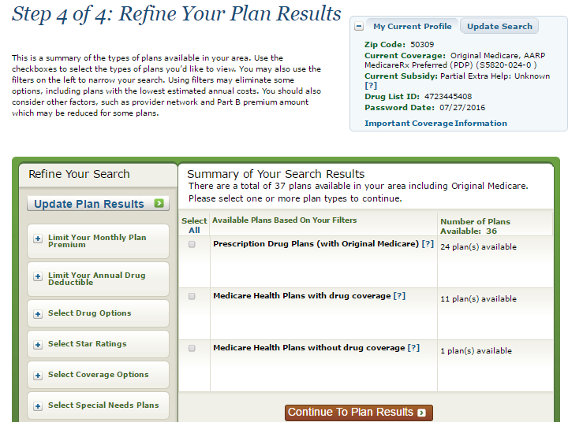
Step 4 of 4: Refine Your Plan Results
Notes:
Step 4 of 4: Refine Your Plan Results
You’ll see the number of plans available in the ZIP Code initially entered (50308). You can use the filter options on the left to help narrow your search.
If you’re working with someone with full Medicare and Medicaid coverage and want to see any Special Needs Plans (SNPs) available, you need to click on “Select Special Needs Plans” and choose to include them in your plan results. These plans don’t automatically display because of the special eligibility requirements. SNPs limit membership to people with specific diseases or characteristics. You can use the Change Health Status filter when you’ve selected you “Don’t want to enter drugs now,” to either “Poor” health (to raise cost estimates) or “Excellent” health (to lower the estimated drug costs that you see in the plan results page).
Finally, you can select the type of plans you’d like to see displayed in the person’s plan results, such as stand-alone Prescription Drug Plans, Medicare Health Plans with drug coverage, and/or Medicare Health Plans without drug coverage. Next, click on “Continue to Plan Results” to continue in Plan Finder once the desired pharmacies have been selected.

Slide 21
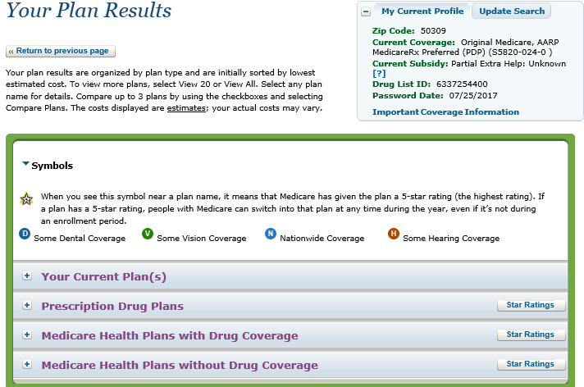
Plan Results Page—Symbols
Notes:
The symbols legend explains the symbols that appear on the page. These symbols display dynamically, and only display when applicable to a plan in the person’s area. For example, the 5-Star rating symbol only appears when there are 5-Star plans available in their area. This slide shows how the plan results are laid out in a collapsed view (to expand view you click [+]). The information starts with Your Current Plan/Coverage followed by Prescription Drug Plans, Medicare Health Plans with Drug Coverage and Medicare Health Plans without Drug Coverage. The Star Ratings feature provides a summary of all the plans’ quality and performance star ratings.

Slide 22
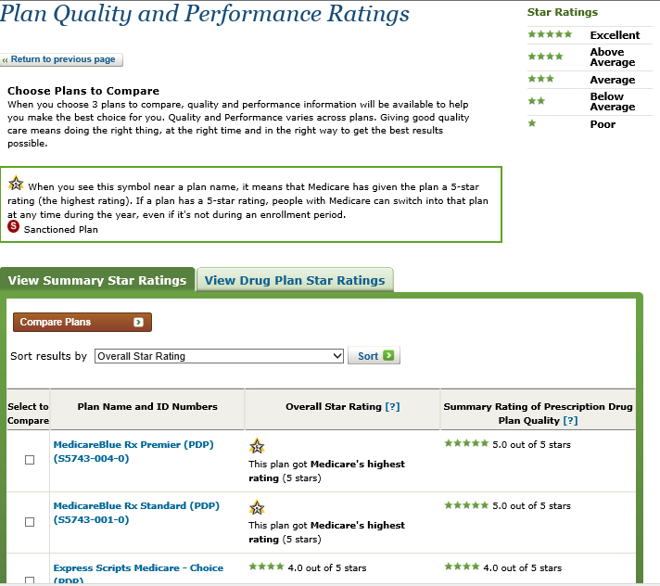
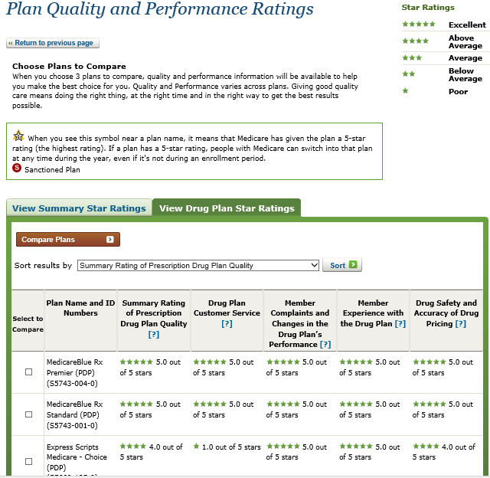
Star Ratings
(Look at Customer Satisfaction, Complaints, Experiences, Pricing)
Notes:
The Star Ratings link provides a complete report and allows you to view and compare the overall plan quality ratings, or specific Plan Star Ratings for customer satisfaction, complaints, experiences, or pricing for all plans in the person’s ZIP Code. There’s also an icon indicating if a particular plan on the list is currently a Sanctioned Plan. This means that CMS isn’t currently allowing the plan to enroll any new members.

Slide 23
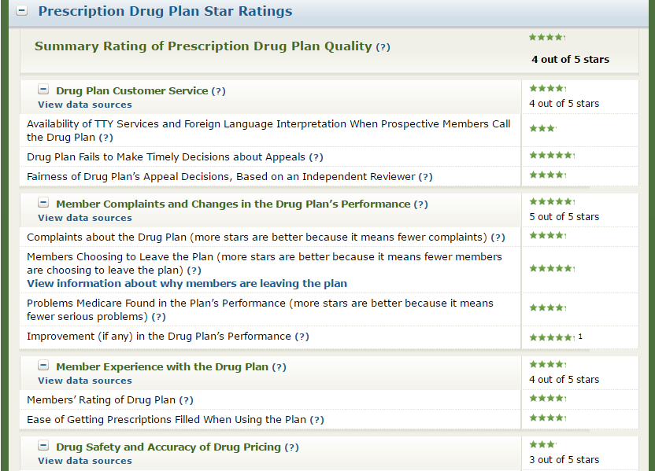
Disenrollment Reasons—Details Page
Notes:
On the Plan Details page, you can click on the “View information about why members are leaving the plan” link to see more information about member disenrollment for a particular plan.

Slide 24
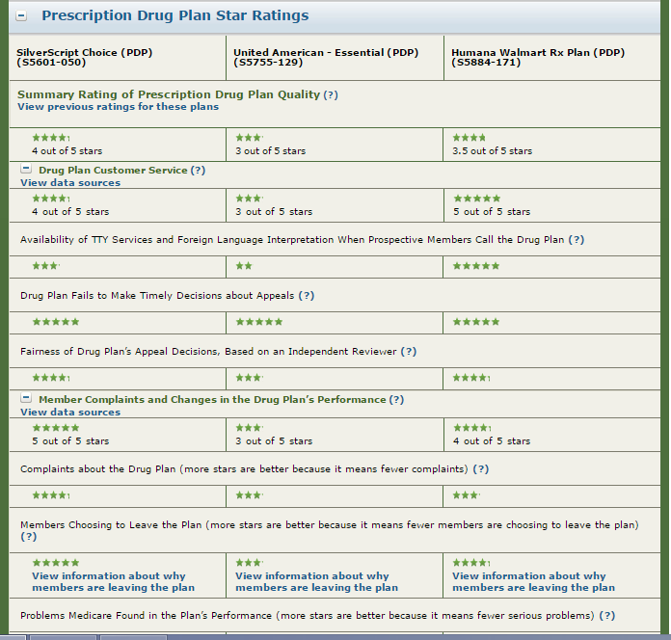
Disenrollment Reasons—Compare Page
Notes:
The member disenrollment information found in the “View information about why members are leaving the plan” link is also found on the Plan Compare page.

Slide 25
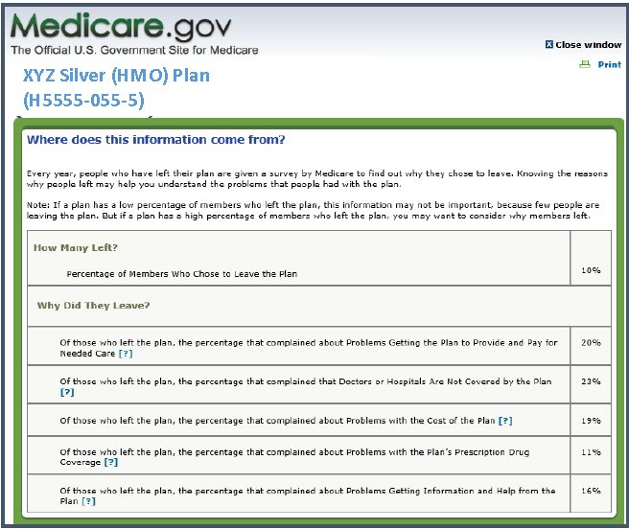
Disenrollment Reasons by Plan Type
Notes:
A pop-up will display with disenrollment reason information for different plan types when selected (for example, Prescription Drug Plans, Medicare Health Plans with Drug Coverage, and Medicare Health Plans without Drug Coverage).

Slide 26
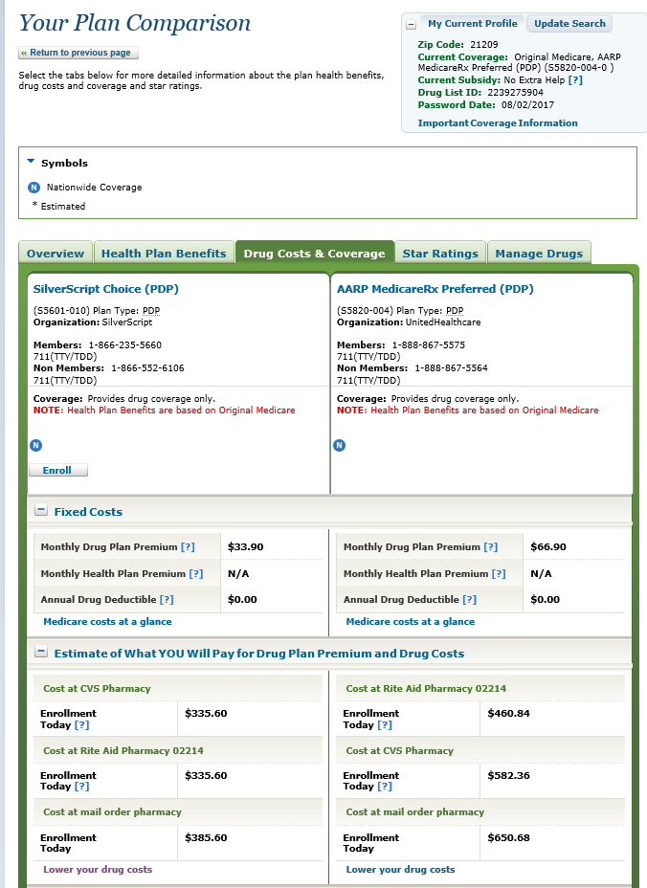
Comparing Drug Plan Costs
When comparing drug plan costs, you can select “Lower your drug costs,” for more information.
Notes:
The Your Plan Comparison page includes key information. Let’s start with the way the plans display and sort by default. The default sort for Prescription Drug Plans is by Drug Costs & Coverage, which includes the plan premium, deductibles, and copayment/coinsurance costs based on the pharmacy selected and drugs entered.
Also included in this column are the pharmacies selected in Step 3. When comparing across plans, you can see in our example that one plan’s network pharmacy may be less expensive than another plan’s preferred network pharmacy. You should also check the convenience of the plan’s preferred network pharmacy locations. Likewise, some people like to sort by lowest monthly cost, but that too is a common misconception. A plan with a low monthly premium doesn’t guarantee the lowest annual drug costs. The deductible, copayment, and coinsurance information is clearly displayed.
Another important feature you should pay close attention to is the Drug Coverage Information section where you can see if all of your drugs are included on the plan’s formulary and Quantity Limits. You can click on either one of these links and see which drugs aren’t in the plan’s formulary, along with any quantity limits/drug restrictions that plan has in place for the drug.

Slide 27
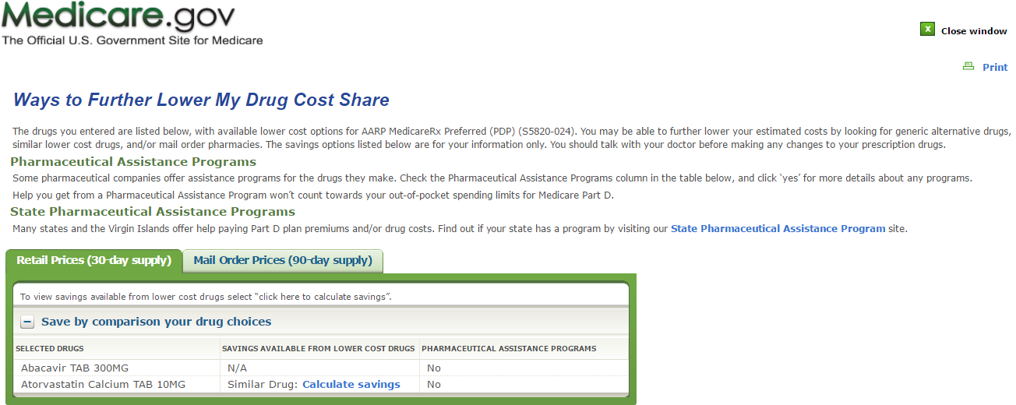
Lower Your Drug Costs—Key Information
Notes:
The Lower Your Drug Costs results pop-up window includes key information about the different ways to help lower their drug costs including:
Pharmaceutical Assistance Program – Some pharmaceutical companies offer assistance programs for the drugs they make.
State Pharmaceutical Assistance Programs – Many states offer help paying for Part D premiums and/or drug costs.
Lower cost alternative drugs and generics – In our example you can see that Lipitor isn’t part of the plan’s formulary, but suggests the lower cost generic option, and shows the new estimated annual cost if they switched to the preferred generic.

Slide 28
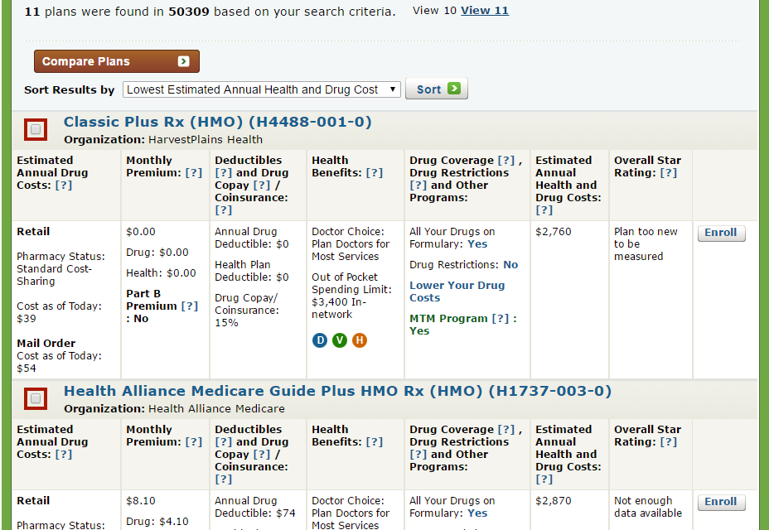
Default Sort for Medicare Advantage Plans with Prescription Drug Coverage
Notes:
When searching Medicare Health Plans with Drug Coverage, you’ll have a slightly different default sort with an additional Estimated Annual Health and Drug Costs column. This is in addition to the first column that details the Estimated Annual Drug Costs alone.

Slide 29
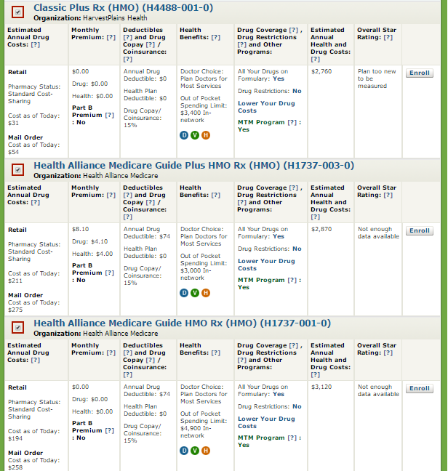
Compare Up to 3 Plans
Notes:
You can compare up to 3 plans side-by-side for the person with Medicare by checking the box, or view a specific Plan Details page by clicking on the plan name.

Slide 30
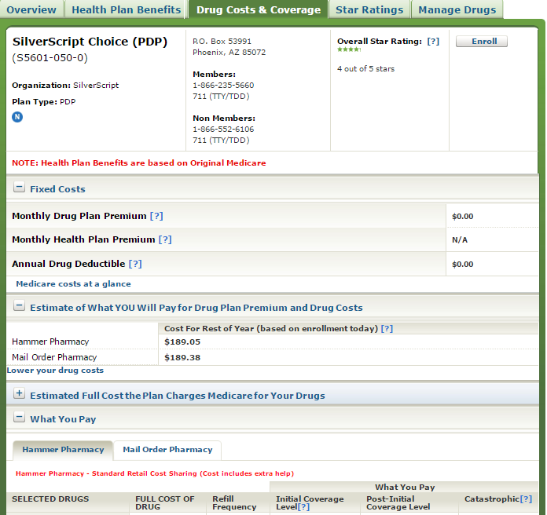
Prescription Drug Plan Details Page
Notes:
The Plan Details page provides plan information across 5 tabs. The default tab for Prescription Drug Plans is the Overview page. The Drug Costs & Coverage page will provide you with more details about the Fixed Costs, and what the person would pay for their drugs for each pharmacy selected including mail order costs.

Slide 31
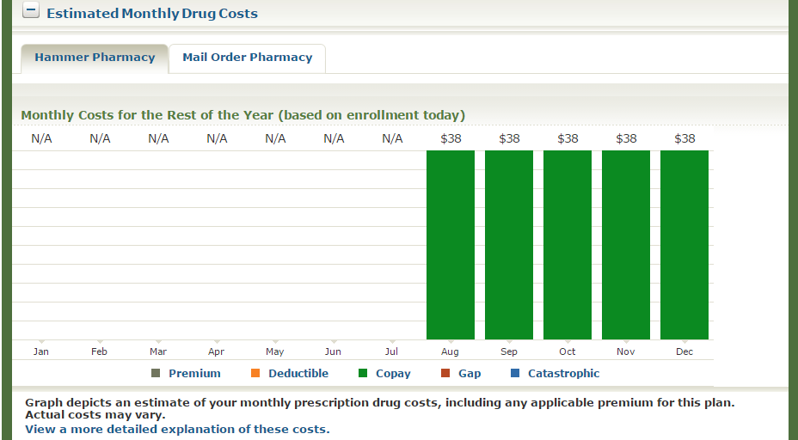
Bar Chart to Show When Changes in
Coverage Levels Occur
Notes:
The Estimated Monthly Drug Costs section shows a bar chart of when changes in coverage occur. You can click on “View a more detailed explanation of these costs” to see more detailed monthly cost information.

Slide 32
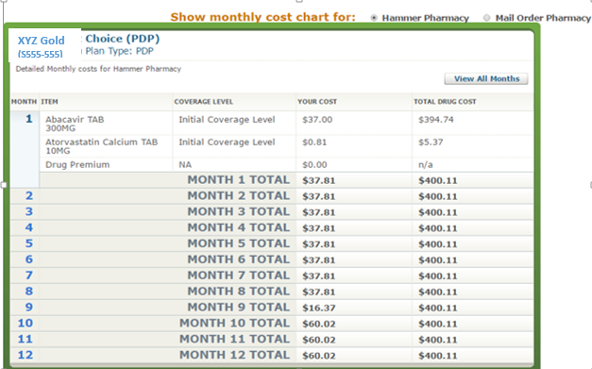
View Details of Costs
Notes:
You can print the detailed costs by pharmacy.

Slide 33
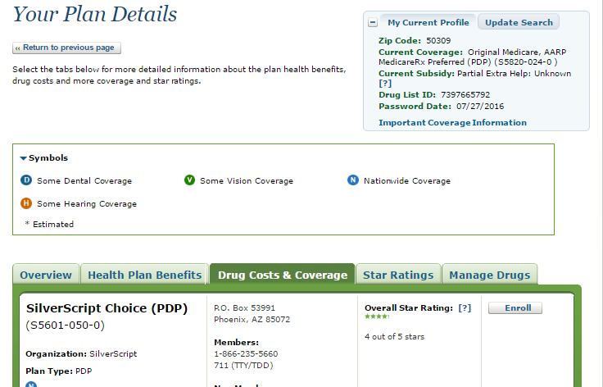
Part B Premium Information
Notes:
The person’s Medicare Part B premium information will display on the initial Your Plan Results page as well as in the Your Plan Details page. If you click on the Overview tab, the Part B premium information will display in the Costs section.

Slide 34
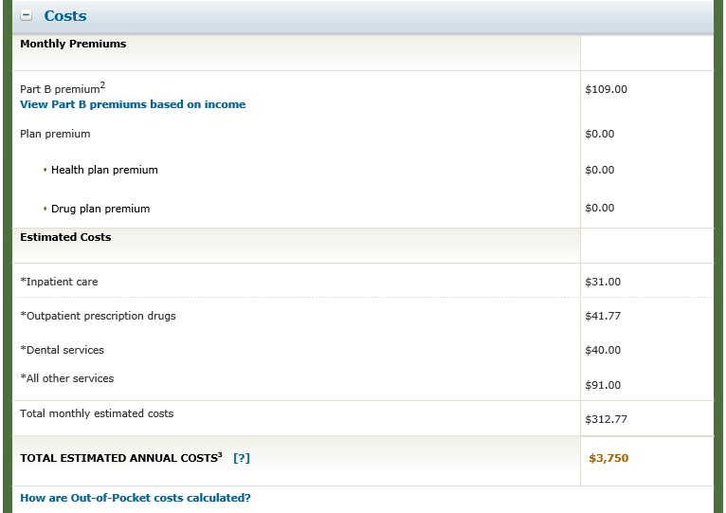
Part B Premium Link
Notes:
You’ll also have access to the View Part B premiums based on income link that displays in the Costs section of the Overview tab, as well as the Compare tab. This link navigates the user to the Medicare Part B costs page in a new tab (Medicare.gov/your-medicare-costs/part-b-costs/part-b-costs.html).

Slide 35
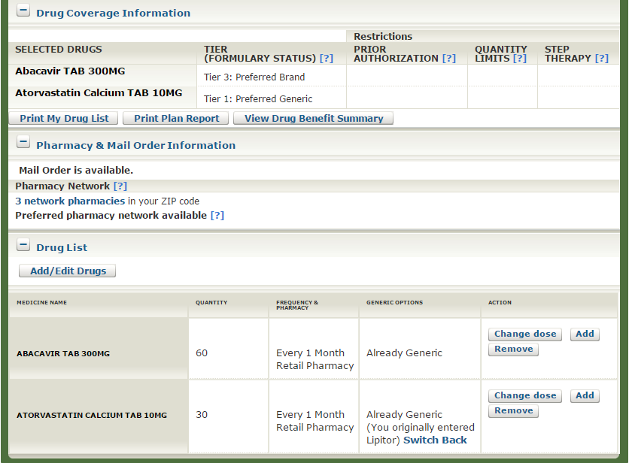
Plan Details—Drug Coverage
Notes:
The Drug Coverage Information section allows you to Print a Plan Report. The View Drug Benefit Summary section lists drug costs by Network and Preferred Network pharmacy. You can also view the plan’s Pharmacy Network and you have the ability to make some updates to the person’s drug list on the Drug tab instead of having to go back to Step 2: Enter Your Drugs.

Slide 36
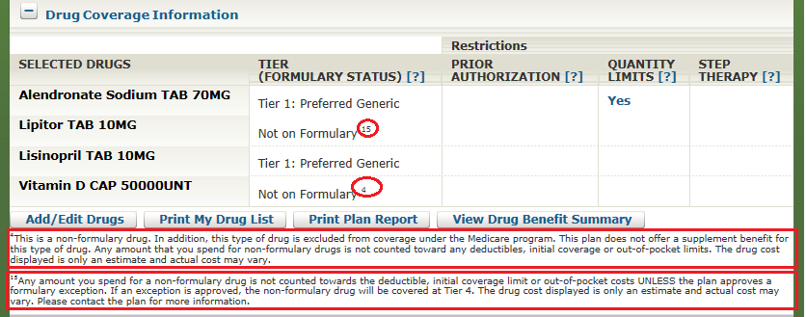
Drug Coverage Information
Notes:
Pay close attention to any footnotes that display specific information about drug coverage.
For example, footnote 4 displays because prescription vitamin and mineral products are drugs excluded by law under Part D. Plans may choose to cover excluded drugs at their own cost, or share the cost with the enrollee, but any amount that they pay for non-formulary drugs isn’t counted toward any deductible, initial coverage, or out-of-pocket costs.
Footnote 15 displays when the drug isn’t part of the plan’s formulary, and again, any amount the enrollee spends for a non-formulary drug isn’t counted towards the deductible, initial coverage limit, or out-of-pocket costs unless the plan approves a formulary exception.

Slide 37
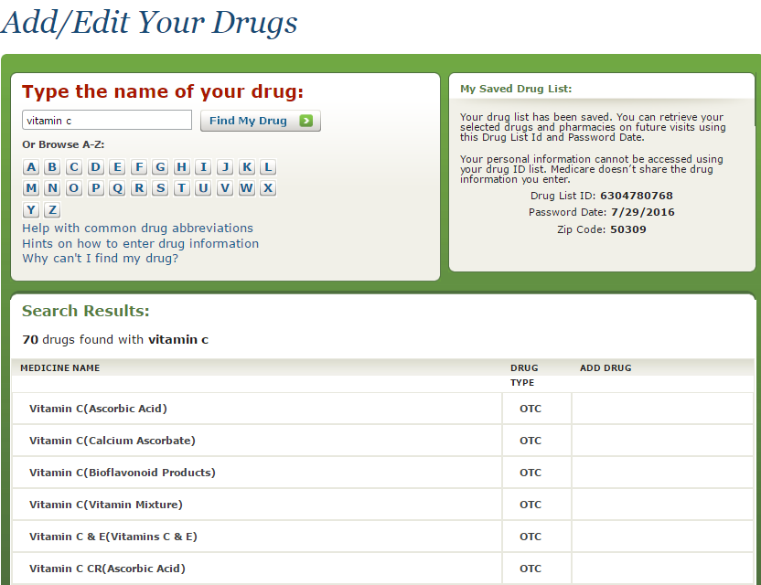
Over-the-Counter (OTC) Drug Coverage Information
OTC drugs are generally not covered.
Notes:
The Plan Finder tool will tell you if you’ve entered any drugs that are available over-the-counter or “OTC.” These generally aren’t covered.

Slide 38
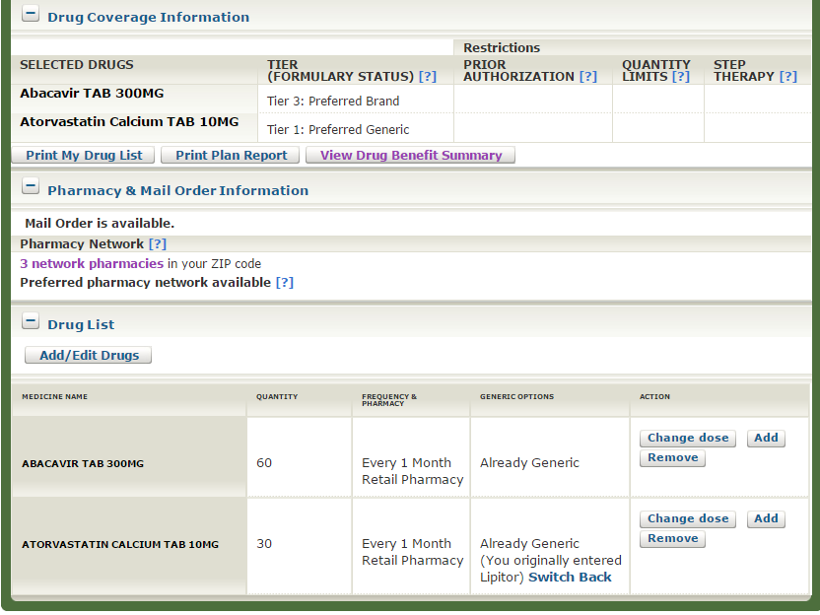
View Drug Benefit Summary
Notes:
Let’s take a closer look at the View Drug Benefit Summary link located under the Drug Coverage Information section.

Slide 39
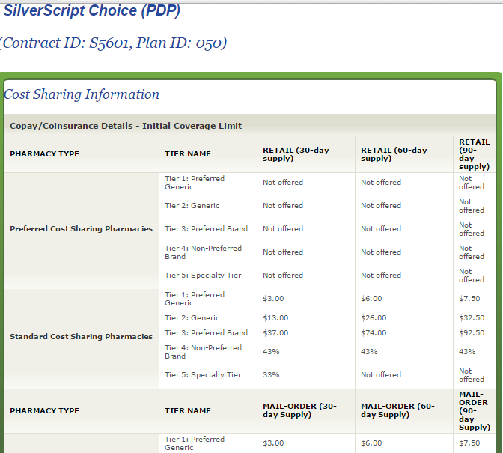
View Drug Benefit Summary Page—
Find Preferred Pharmacy Prices
Notes:
The View Drug Benefit Summary page is a resource that shows you the plan’s drug pricing by tier and whether the plan offers 30-day, 60-day, 90-day, and Retail and/or Mail Order pricing. You can also see whether the plan offers Preferred Cost sharing pharmacy pricing and compare it to its Standard Cost sharing pharmacy pricing.

Slide 40
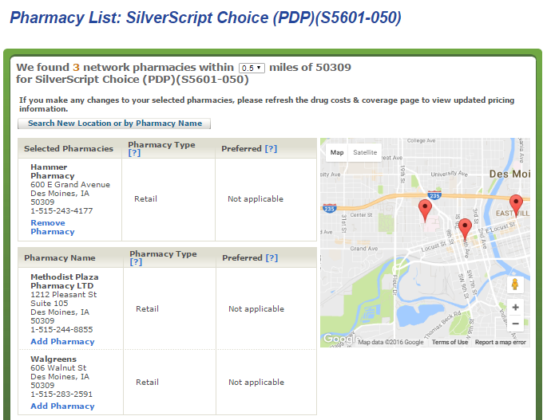
View Pharmacy Network
Notes:
You can view the plan’s pharmacy network by clicking the blue “Network pharmacies” link. The pop-up will list all the pharmacies in the plan’s network and indicate which are preferred pharmacies, if applicable (you can use the drop-down arrow to expand the radius). Here you have the opportunity to remove an existing pharmacy and/or add another pharmacy in its place without having to return to Step 3: Select a Pharmacy.

Slide 41
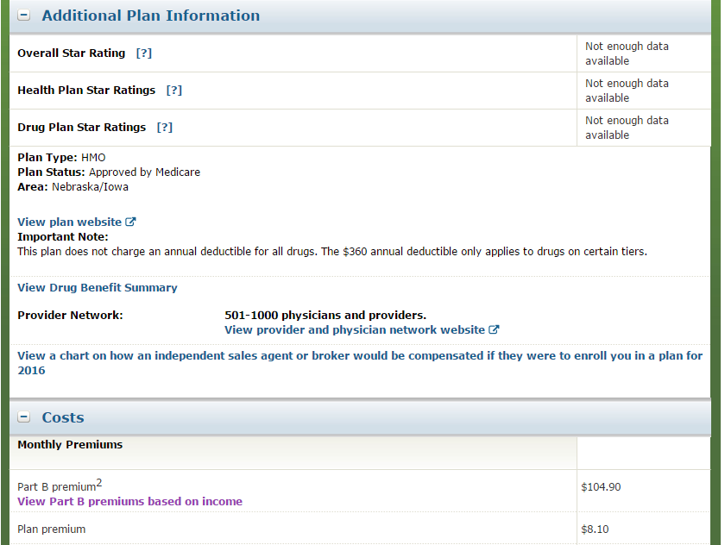
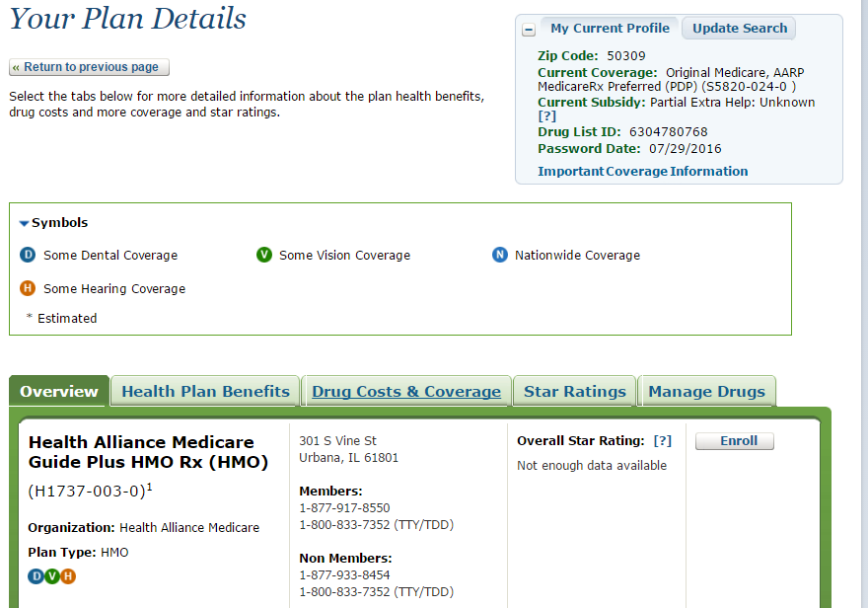
Medicare Health Plan with
Prescription Drug Coverage View
Notes:
When viewing Medicare Health Plans with Prescription Drug Coverage, the Plan Details page will default to the Overview tab where you can find helpful information such as the plan’s website, any important notes specific to the plan’s offering, and when viewing a Special Needs Plan (SNP) any chronic condition or criteria required for enrolling in the plan. The Overview tab also provides a link to the plan’s provider and physician network.

Slide 42
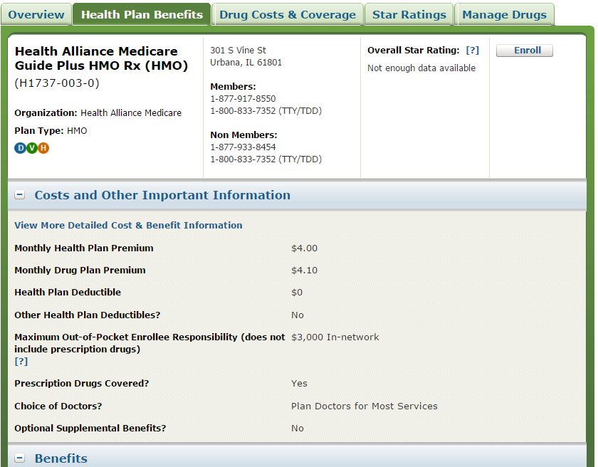
Health Plan Benefits Tab—
Costs and Other Important Information
Notes:
The Health Plan Benefits tab includes the costs and other important information such as whether the person will have their choice of doctors, or if the plan offers optional supplemental benefits.

Slide 43
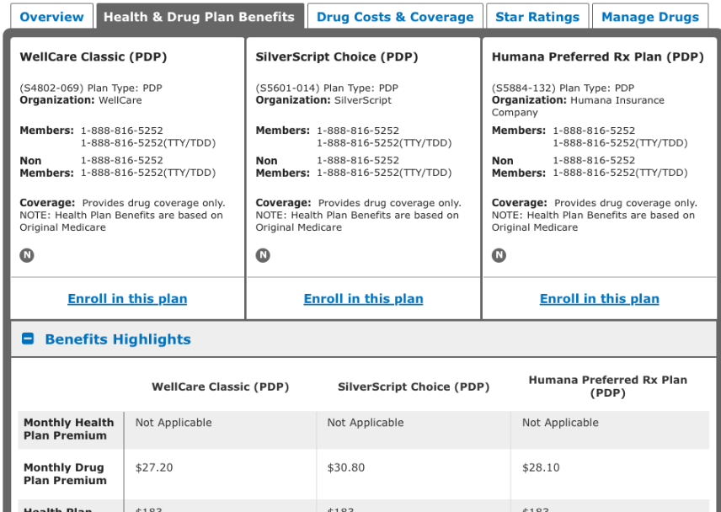
Health & Drug Plan Benefits
Notes:
The Health & Drug Plan Benefits tab will display a summary of the top basic benefits and costs. You can find information on a Plan’s Benefits Services, Drug Plan Information, and Optional Supplemental Benefits such as Mental health, vision, dental, hearing, and chiropractic care.

Slide 44
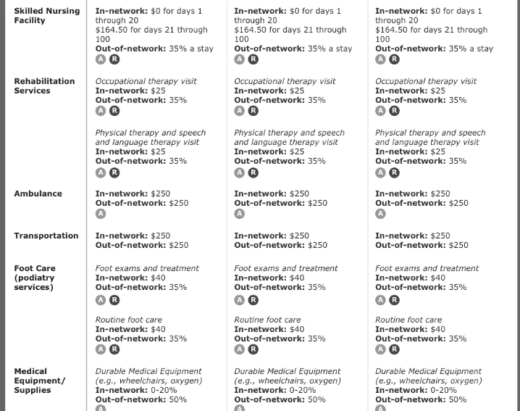
View More Benefits
Notes:
Once you click on “View More,” the Benefit Highlights will expand to display the plan’s benefits in much greater detail. You’ll see information about inpatient and outpatient hospital coverage, doctor visits, preventive care, skilled nursing facility, rehabilitation services and much more.

Slide 45
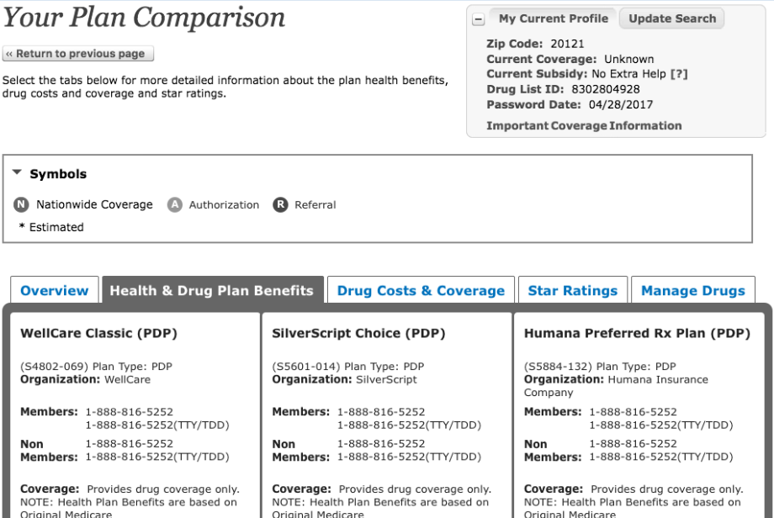
Compare Plans Side-by-Side
Notes:
When comparing up to 3 plans side-by-side, you can view all the same information we discussed on the Health & Drug Plan Benefits page. The plans will display left to right in order by their Contract ID number.

Slide 46

Comparing Fixed Costs
Notes:
On the Drug Costs & Coverage tab you can compare the plans’ fixed costs, including the monthly premium and annual deductible.

Slide 47

Comparing Your Out-of-Pocket Costs
Notes:
You can compare what they’ll pay for their drug plan premium and drug costs for the remainder of the year at different pharmacies and by mail order.

Slide 48


Compare and Print—View Drug Cost Summary
Notes:
The View Drug Cost Summary section will include a plan comparison for each of the pharmacies selected.

Slide 49

Print Comparison Report
Notes:
You can compare which drugs are covered and view any drug restrictions. As with the Plan Details page, you can print a Comparison Report customized to the person’s needs.

Slide 50

Compare Plans—Drug Updates
Notes:
You can make changes to the drug list. For example, you can add or remove drugs you’ve entered or change the dose. Remember that changes made can affect pricing.

Slide 51


Online Enrollment Center
Notes:
When you’re ready to help the person enroll, you can click the plan’s “Enroll in this plan” button. You’ll be directed to the Online Enrollment Center.

Slide 52


Start Enrollment—Special Enrollment Period
Notes:
To start enrollment outside of the Open Enrollment Period (October 15 to December 7), you’ll need to select the applicable Special Enrollment Period life event that applies to the person with Medicare such as losing creditable coverage or moving out of the plan’s service area.

Slide 53

Entering Personal Information
Notes:
Before you begin to enter the person’s information, State Health Insurance Assistance Program (SHIP) counselors should click on the watermark “Department of Health and Human Services (DHHS)” logo. This will add the Partner Information section to the online application below the Personal Information section that allows you to enter your 10-digit office telephone number. Remember, this information allows CMS to track all SHIP-assisted enrollments. Agents and brokers also use this feature to enter their enrollments when using the Online Enrollment Center.

Slide 54

Enrollment Confirmation Notice
Medicare Health XYZ Plus (PPO)
Notes:
Upon completing the enrollment application, the person you’ve helped will get a confirmation notice that says “Enrollment Request Received,” along with a confirmation number. Be sure to write down and print the application information as a record for the person with Medicare. Remember, the confirmation number can be used later to check on the status of the application using the Check Your Enrollment tool discussed earlier on slide 6.

Slide 55

Programs of All-Inclusive Care for the
Elderly (PACE) Plans
Notes:
Under Additional Tools on the home page, you can find information about Programs of All-Inclusive Care for the Elderly (PACE) Plan(s) by clicking the “Find PACE Plan(s)” link. PACE is a Medicare and Medicaid program offered in many states that allows people who otherwise need a nursing home-level of care to remain in the community.

Slide 56

PACE Plans—Results Page
Notes:
The Your Plan Results page displays the PACE plans for the state selected. The Plan ID column contains the Plan ID and Contract ID. The Plan Name column header is a link which, when clicked, will open contact details for the plan. The plans can be sorted in ascending and descending order by Plan ID and Plan Name. The Online Enrollment Center (OEC) available through the Plan Finder won’t allow enrollment into the PACE Plans listed on the PACE page. The enrollment criteria and availability are provided by the individual PACE Plan using the contact information shown.

Slide 57

PACE Plans—Details Pop-Up
Notes:
PACE Plan details will display in a pop-up that contains the plan’s contact information such as their telephone and TTY numbers, hours of operation, and website URL.

Slide 58

Find and Compare Medigap Policies
Notes:
Under the Additional Tools section on the homepage of the Medicare Plan Finder, you can Find and compare Medigap policies.
You enter your ZIP Code and can optionally choose your health status from the drop-down list as “Good,” “Poor,” or “None of the above.” Next, you should indicate if you have a Medigap Policy by selecting the appropriate button of “Yes” or “No.”

Slide 59

Compare Medigap Policies—Results Page
Notes:
The View All Medigap Policies results page will default to show you all of the Medigap Policies available in the ZIP Code you entered by policy letter type. A Policy Summary will display for each letter type including: the monthly premium, estimated annual cost, and a brief list of benefits. For every policy letter type available, you can select View companies that offer Medigap Policy X and View All Benefits. By selecting View companies that offer Medigap Policy X, you’ll see contact information for every company that offers that policy letter in your ZIP Code, and how the monthly premium pricing methodology or “rating” is determined (e.g., Community-Rated, Attained-Age-Rated, or Issue-Age-Rated).
At the top left side of the screen, you also have the option to View Policies by Company. This will allow you to select from a list, the specific companies whose Medigap Policy offerings you’re interested in seeing.
You can contact the plan directly for more information and enrollment options.

Slide 60
Training Scenario—Walk Through
CMS has a training site URL where you can practice navigating the Plan Finder: Training.medicare.gov
Tom Jones has Original Medicare and no subsidy.
  ZIP: 50309
  HICN: 555555555A
  Name: Jones
  Part A effective date: August 1991
  DOB: August 1, 1925
NOTE: This web site may load pages significantly slower than the public tool. The Online Enrollment Center (OEC) isn’t accessible on the training site.
Notes:
CMS has a training site URL where you can practice navigation on the Plan Finder. Use this practice scenario to walk through what you’ve learned.

Slide 61
List of Drugs to Enter
Hydrochlorothiazide TAB 25MG 90 Every 3 Months, Mail Order Pharmacy
Zolpidem Tartrate Er TAB 6.25MG 30 Every 1 Month, Retail Pharmacy
Losartan Potassium TAB 50MG 90 Every 3 Months, Mail Order Pharmacy
Simvastatin TAB 20MG 90 Every 3 Months, Mail Order Pharmacy
Levothyroxine Sodium TAB 50MCG 90 Every 3 Months Mail Order Pharmacy
Notes:
This is a sample list of drugs to enter when practicing.

Slide 62
Why can't I add an existing drug?
Why isn't my drug listed?
  Plan Finder doesn't include every drug that Medicare covers
  If you can't find your drug, contact the plan to find out if it’s covered
    Frequently asked questions (FAQ’s) are available at Medicare.gov/find-a-plan/staticpages/faq/planfinder-faq.aspx
Notes:
NOTE: The most common frequently asked question is “Why can’t I locate my drug?”

Slide 63
Training Scenario 2—Walk Through
Use the CMS training site URL to practice navigating the Plan Finder: Training.medicare.gov
John Stone is enrolled in a PDP, has Original Medicare and a partial subsidy.
  ZIP: 33025
  Medicare number: 333333333A
  Last name: Stone
  Effective date, Part B, April 2005
  DOB: April 15, 1940
NOTE: This web site may load pages significantly slower than the public tool. The Online Enrollment Center (OEC) isn’t accessible on the training site.
Notes:
Here’s another practice scenario to help you become familiar with the Plan Finder.

Slide 64

Related Video Links
Notes:
There are a series of Plan Finder Multimedia tutorials that are a good refresher before Open Enrollment. For access, you can click on each one to view on the CMS You Tube channel which will open in a new window. You also may access them at Medicare.gov/find-a-plan/questions/home.aspx and see the Plan Finder Multimedia portion of the page.
These tutorials provide a step-by-step overview of how to complete a plan search.
Plan Finder Video Lesson 1: Getting Started
Plan Finder Video Lesson 2: Entering Your Prescription Drugs
Plan Finder Video Lesson 3: Selecting Pharmacies
Plan Finder Video Lesson 4: Refining and Sorting Your Plan Results
Plan Finder Video Lesson 5: Comparing Plans

Slide 65

This Training is Provided by the
CMS National Training Program (NTP)
To view all available NTP training materials,
or to subscribe to our email list, visit
CMS.gov/outreach-and-education/training/CMSNationalTrainingProgram.
Stay connected.
Contact us at training@cms.hhs.gov, or
follow us @CMSGov #CMSNTP
Notes:
This training is provided by the CMS National Training Program (NTP).
To view all available NTP materials, or to subscribe to our email list, visit CMS.gov/outreach-and-education/training/CMSNationalTrainingProgram.
Contact us at training@cms.hhs.gov.
Follow us @CMSGov #CMSNTP.

