Slide 1
CMS IT Governance Training
Life Cycle ID (LCID)
Expiration & Next Steps
Notes:
Welcome to, CMS IT Governance Training, LCID Expiration and Next Steps
In this brief presentation we’ll explain what a Life Cycle ID Expiration is, how we handle upcoming Life Cycle ID expirations, and the next steps to take for a project team.

Slide 2
What is a Life Cycle ID?
A Life Cycle ID (LCID) serves as a record of approval for your planned IT activities, from a capital investment and planning perspective.
The CMS IT Governance function issues LCIDs during the Initiate phase of the Target Life Cycle.
The EASi System generates LCIDs and also distributes them via email.
LCIDs expire upon the end of a contract’s Period of Performance (PoP) or a project’s Target Completion Date.
This expiration of a LCID is in place so the CMS IT Governance Team can get an update on the status of a project.
Notes:
A LCID is a record of approval for your IT Planned activities, from a capital investment and planning perspective.
LCIDS are issued by the CMS IT Governance Function during the Initiate phase of the Target Life Cycle.
The CMS IT Governance Team has actually covered both what a LCID is, and intro to the TLC in other trainings available here on the TLC Training Library on CMS.gov

Slide 3
Why do LCIDs Expire?
LCIDs expire for a number of reasons:
Provides a check-in point for CMS IT Leadership to stay up to date with your IT development work, and offer technical assistance if needed.
Allows for planning lead time to ensure you’re familiar with the next steps through IT Governance.
Federal legislation requires IT Governance to review and approve each new or recompeted contract.
LCIDs expire upon the end of a contract’s Period of Performance (PoP) or a project’s Target Completion Date.
Notes:
So why do LCIDs expire?
LCIDs have a fixed expiration date for a number of reasons:
First, if you are engaged in IT development work, it provides a check-in point for CMS IT leadership to stay up to date with how development is going and offer technical assistance to your project if needed.
Second, it allows for planning lead time and informs you about any needed next steps within the CMS IT Governance framework
Third, federal legislation requires the IT Governance function to review and approve each new or re-competed contract, and so old LCIDs are retired and new LCIDs are issued at the point of contract review, denoting a completed review.
LCIDs expire upon the end of a contract's Period of Performance or a project's Target Completion Date, and may be extended as needed
Finally, the LCID timeline keeps your CMS IT System profile up to date with where you are in the Target Life Cycle, simplifying IT governance reviews.

Slide 4
Handling an Upcoming LCID Expiration
CMS IT Governance Team keeps track of LCIDs and reaches out to project teams prior to the LCIDs expiration.
Project teams will be sent an email from the IT Governance Team, asking to provide a quick update on the project’s status.
Check One | Project Status
 | IT Development Projects
☐ | Initial development completed, project is live in production as of date: __________. Final contract option year expires on date: ________.
☐ | Initial development partially completed, and on schedule to be live in production as of date: ________. Final contract option year expires on date: ________.
☐ | Development effort is encountering difficulties and we’d be interested in learning more about available technical assistance. Target completion (live in production) date is _________.
☐ | Project cancelled
☐ | Project on hold
 | O&M Projects/Services Contracts
☐ | This contract is not being extended and will end on date: __________. New contract action being planned (re-compete, IAA) - target date for release of solicitation, if applicable, is: _________. Target award date is: ________.
☐ | Contract extension (not re-compete) is being planned with new planned contract expiration date of: __________.
☐ | Contract support no longer needed
Notes:
How are LCID expirations handled?
The CMS IT Governance Team keeps track of all LCIDs issued for IT Projects and reaches out to project teams prior to expiration of the LCID
The IT Governance team will send an email with all the details of the project, and will ask the project team for a quick update on the project's status.
The email includes a simple table, where the project team checks a box, and if needed provides updated dates for the project's Period of Performance or Target Completion Date. LCIDs may then be extended as needed.
A quick run-down of the statuses provided for IT Projects in Development are:
"Initial Development completed, and project is live in production". Here we ask the project team to provide the live production date as well as the end date of the final option year of the contract. This status denotes the successful completion of a project or MVP and the transition to the Operate phase of the TLC.
"Initial development partially completed, and on scheduled to be live in production". Much like the previous status, we ask the project team to provide the scheduled go live date, and the end date of the final option year of the contract. This status demonstrates that you may need to stay in the Develop Phase of the TLC a bit longer than initially anticipated, and it will establish a new check-in point with IT governance at a later date.
"Development effort is encountering difficulties and we'd be interested in learning more about available technical assistance". Here, the project team would solely provide their target completion date, and the CMS IT Governance team would follow-up with the project team to set-up a small meeting with the appropriate subject matter experts to discuss options and help with any issues the project team may be facing.
The final two options for IT Projects in Development are "Project cancelled" and "project on hold".
For IT Projects or services that are in O&M, the statuses provided are:
"The current contract Period of Performance, is not being extended" Where the project team simply enters the Period of Performance end date as well as whether "A new contract action (Re-compete) is being planned" and what the timeline is for that procurement.
"An extension (not a re-compete) of the current period of performance is being planned" and the project team provides the new planned contract expiration date.
And finally, "Contract support is no longer needed".
If you're unsure of what option to select, or if none of the provide options are an exact fit, you can provide your own status, or reach out

Slide 5
Handling an Upcoming LCID Expiration (Inter Agency Agreements)
CMS IT Governance Team keeps track of all IT related IAAs LCIDs and reaches out to project teams prior to the IAAs POP expiration
Questions asked by the IT Governance Team for upcoming IAA LCID Expirations:
Please respond as to whether this IAA will be renewed and include the information below:
Describe any planned changes to service requirements
How much of a cost increase do you anticipate over what you are currently spending?
What is the new PoP?
If IT development work is occurring, when is the project scheduled to be live in production? Please also let us know if you’d like to learn more about available technical assistance.
Notes:
Much like the status for standard IT contracts, the IT Governance Team will also reach out prior to the end of the Period of Performance for IAAs.
Here the IT Governance Team doesn't provide a set of statuses to choose from, but instead asks a few simple questions regarding the IAA. IAAs often don’t change significantly from year to year, and IT Governance generally can extend your LCID expiration date, rather than issuing you a new one
These questions are:
Will the IAA will be renewed?
Describe any planned changes to service requirements
How much of a cost increase do you anticipate over what you are currently spending?
What is the new PoP
If IT Development work is occurring, when is the project scheduled to be in live production
And to please let us know if you'd like any technical assistance.

Slide 6
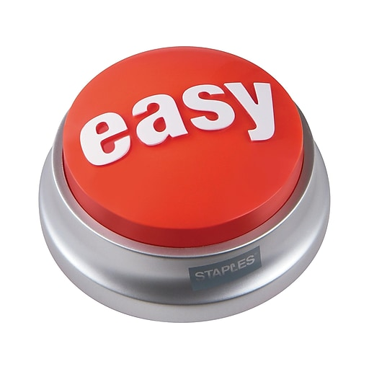
Next Steps
Check one of the statuses, and provide an updated PoP or Target Completion date where necessary. THAT’S IT!
IT Governance Team will follow-up to your response with any applicable information and provide a new LCID expiration date, if applicable
Notes:
The next steps for project teams is pretty simple. All you have to do is select one of the statuses for your project, or provide quick answers to the questions posed for IAAs, that we covered previously, and input dates where provided, and that's it.
From there, the IT Governance team handles your response with any applicable information or needed next steps, and will extend your LCID if necessary and provide you the new LCID expiration date for your project or IAA, and will follow up again, prior to that new expiration date provided.

Slide 7
Contact Us
For questions about IT Governance, or more information, you may contact us at IT_Governance@cms.hhs.gov.
For more information, or to access the other trainings mentioned, as well as numerous other trainings and information we provide, please visit IT Governance - https://www.cms.gov/TLC.
Notes:
For questions about IT Governance, or for more information, you may Contact Us at IT underscore Governance at CMS dot HHS dot gov
For more information, or to access the other trainings mentioned, or numerous other trainings and information we provide, please visit www dot CMS dot gov slash TLC.

