Slide 1

LTSS in Indian Country
How tribes can build
Long-Term Services and Supports
for elders and people with disabilities

Slide 2

The Situation
American Indians and Alaska Natives are steadily growing older. Many AI/ANs with disabilities need care.
    There will be 2.5x as many AI/AN elders by the year 2030 as there were in 2012
    More than 50% of AI/AN people aged 65+ have a disability
    1 out of 3 of the AI/AN adults with disabilities in need of care are younger than age 65
Notes:
U.S. Census Bureau. “An Aging Nation: The Older Population in the United States.” Page 12. Current Population Reports. 2014. Retrieved from http://www.census.gov/prod/2014pubs/p25-1140.pdf
U.S. Census Bureau, “Age by Disability Status (American Indian and Alaska Native Alone,” 2013 American Community Survey, retrieved from http://factfinder.census.gov/faces/tableservices/jsf/pages/productview.xhtml?pid=ACS_13_1YR_B18101C&prodType=table
Kaiser Family Foundation Analysis of the American Community Survey. 2013. Retrieved from http://kff.org/report-section/the-role-of-medicare-and-the-indian-health-service-for-american-indians-and-alaska-natives-health-access-and-coverage-report/

Slide 3
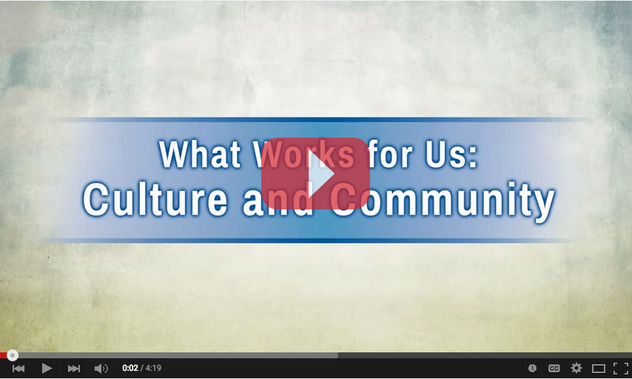
Tribal programs of Long Term Services and Supports (LTSS) can speak to tribal needs and deliver culturally competent care.
“We’re all connected,
and being relatives in the Native American tradition, we adhere to certain ways of living and looking at the world.”
—John Molina, Phoenix Indian Medical Center
What Works for Us: Culture and Community
Video 4:19

Slide 4


Tribal LTSS Programs
Three Examples

Slide 5
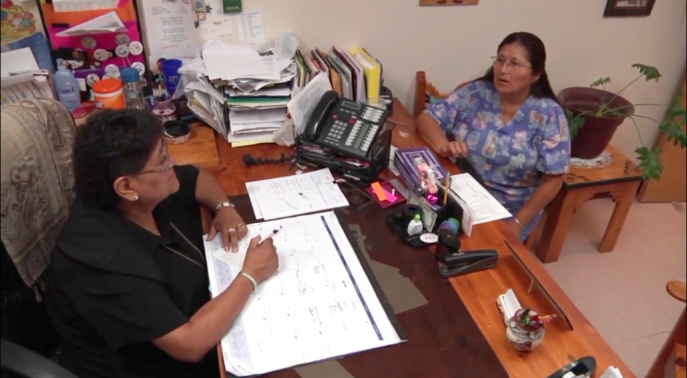
Pueblo of Zuni LTSS Network
Senior center
Senior companion program
Adult day center
Home health services
IHS hospital elder services program
Palliative care
Elderly Services Coordinating Committee
“The advice I would give is that [tribes] need to know their elders’ needs in their community, what will work for them, what is doable, because each tribe is different.”
—Karen Leekity,
Zuni Elder Services Director

Slide 6
White Earth Long Term Care Consultation
A division of the tribal health service
Contracts with state of Minnesota to administer 5 Medicaid waiver programs for elders and disabled individuals who live on its reservation
Tribal staff offers
  Medicaid applications
  Case management
  Eligibility assessments

Slide 7
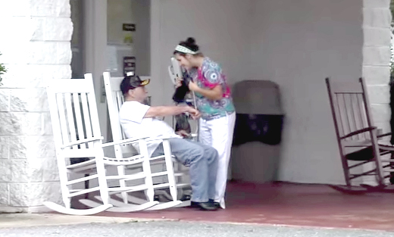
Eastern Band of Cherokee LTSS Network
Tsali Care, a 60-bed nursing facility
Home health program, including
  Skilled nursing
  Disability services
  Aide services
  Therapist services (physical, occupational, and speech)
  Respite services
Tribally operated hospital and ambulatory clinics
Strong referral network among all services
“… it’s hard to address every single issue within a community. But if we’re addressing the most relevant and the most important, I think we’ve done our job right.”
—Former Chief Michell Hicks

Slide 8
What is LTSS?

Slide 9
What is LTSS?
Care and support of an elder or person with a disability who requires ongoing assistance with daily living tasks
Medical, personal, and social services delivered in a variety of settings
Support for caregivers

Slide 10
LTSS Health Services
Caregiver and client training
Case management
Dietary management by dieticians
Disease prevention
Durable medical equipment
Health promotion
Hospice care
Medication management
Occupational therapy
Pharmacy
Personal emergency response systems
Physical therapy
Respite care for caregivers
Skilled nursing
Speech therapy

Slide 11
LTSS Human Services
Adult day care or senior centers
Financial management, help with bill-paying
Home-delivered meal programs
Home safety assessments, repairs, and modifications
Homemaker and chore services
Nutritional meals at congregate sites
Information and referral services
Legal services
Personal care (dressing, bathing, etc.)
Telephone reassurance
Transportation and access

Slide 12
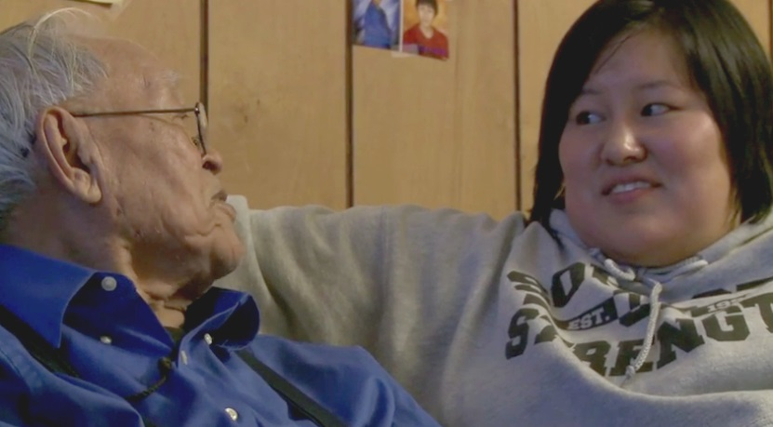
LTSS Providers
90% of elder care in Indian Country is provided by family members.
Other providers include:
  Physicians
  Nurses
  Nurse aides
  Personal attendants

Slide 13
LTSS Locations
  Homes and community centers
    Desired by most tribal members
    Supported by tribal values and history
    Medicaid funding favors this option
  Facilities
    Skilled nursing facilities, nursing homes, assisted living facilities, hospice facilities
  In Between
    Transitional programs to support people as they move from facilities back into their communities

Slide 14
LTSS Partnerships
Tribes with LTSS programs learn to understand, integrate, and coordinate many resources
  State
  Federal
  County
  Tribal
  Local

Slide 15
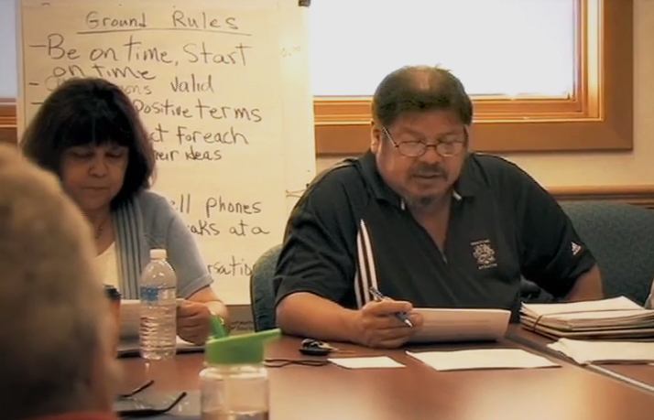
“What we have found is the more we partner not only with the various tribes but with the state government and the federal government, the better things are.”
—David Larson, Oneida Tribe of Indians of Wisconsin

Slide 16
LTSS Financing

Slide 17
Medicaid
Source: Estimates based on CMS National Health Expenditure Accounts data for 2013.
Notes:
Estimates by Kaiser Commission on Medicaid and the Uninsured. Accessed online here: http://kff.org/medicaid/report/medicaid-and-long-term-services-and-supports-a-primer/

Slide 18
Federal Medical Assistance Percentage (FMAP)
FMAP is the percentage the federal government pays to states for Medicaid expenses
Each state’s FMAP is different
  Average FMAP to states is 57%
but
FMAP for services provided to Medicaid-eligible AI/AN patients in tribal or IHS facilities is 100%.
    Tribes can increase capacity
    States can save money
    Tribes may need to educate states about 100% FMAP

Slide 19
Medicaid Waivers
Medicaid waivers let states design new programs tailored to particular needs and focusing on
  Particular conditions (mental health, developmental disability)
  Statewide or limited to a region or county
Waivers are the main way home- and community-based services are delivered and funded
  Section 1915 Waivers: Delivering long-term care in home and community settings

Slide 20
Other Funding Sources
Medicare
IHS
  IHS can fund LTSS under the Indian Health Care Improvement Act, but LTSS must be explicitly added to your tribal contract or compact.
Older Americans Act (Title VI) – Nutrition programs, senior centers, homemaker services
Veterans Administration
State and local programs
Tribal funds
Long-term care insurance
Private pay

Slide 21
Should Tribes Use Grants for LTSS?
Yes
No
For one-time or short-term needs involving planning, new programs, and activities
To bridge the
start-up and implementation phases
For operating costs like staffing or overhead
  For these, tribes need sustainable funding

Slide 22
LTSS Program Models

Slide 23
Two Main Models
Home- and Community-Based Services (HCBS)
  A person lives in their own (or a family member’s) home
  Caregivers may come to or live in the house
  The person may travel to access other services (e.g., going out to a senior center)
Facility-Based Care
  A person lives in a facility and receives all care there
  Many specialized services may be available onsite

Slide 24
Other Models
Specialized LTSS models can be funded through federal or state programs
Program of All-Inclusive Care for the Elderly (PACE)
    Tribal example: Cherokee Elder Care, Tahlequah, OK
Money Follows the Person–Tribal Initiative
Tribal initiative has 5 state grantees (MN, OK, ND, WA, and WI)
Medicare Special Needs Plan
    A type of Medicare Advantage plan, including a specialized physician and hospital network

Slide 25
Getting Started

Slide 26
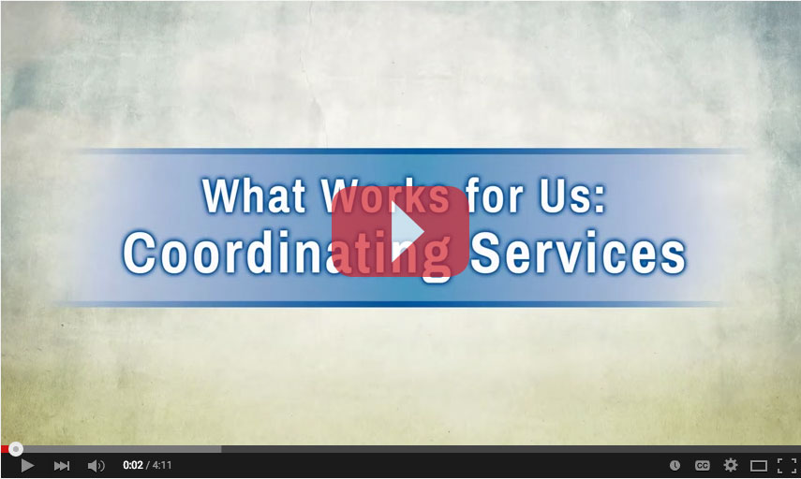
Early and Interim Steps
Involve tribal stakeholders in decisions
Become familiar with current state, local, and federal programs supporting LTSS
Look for partner programs to share resources
“One of the things we’ve all learned to do is to listen to the elders and then work with each other.”
—Jane Smith, Anna Johnson Nursing Home, Oneida Nation of Wisconsin
What Works for Us: Coordinating Services
Video 4:12

Slide 27
Early and Interim Steps
Make the most of Medicaid
  Build relationships with state Medicaid officials
  Sign up more tribal members
  Review services you already provide; some may be eligible for reimbursement
Recruit caregivers in advance
  Hiring caregivers in rural areas can be challenging
Prepare to follow the LTSS Roadmap for Planning on cms.gov
  7 planning steps for programs

Slide 28
Resources

Slide 29
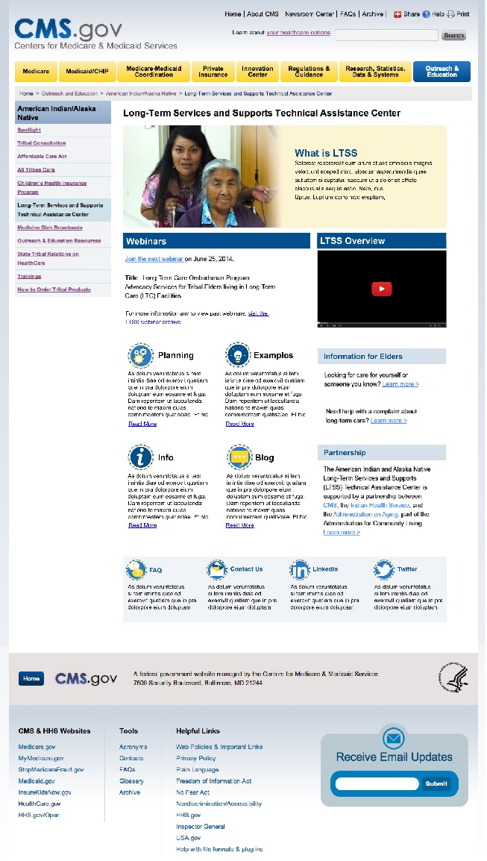
Visit the LTSS Technical Assistance Center http://go.cms.gov/aian-ltss
Best practices
Studies and data
Examples
Videos
Webinar archives
Newsletter archives
Medicaid plans and waivers by state
LTSS Roadmap for Planning

Slide 30
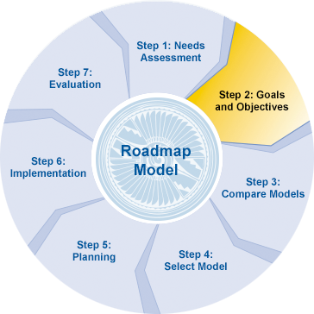
LTSS Roadmap for Planning
A step-by-step guide for tribal health program planners
Located on the LTSS Technical Assistance Center website on cms.gov
  http://go.cms.gov/aian-ltss

Slide 31



Stay Connected
Join the LTSS email list
  Announcements for regular LTSS webinars
  Monthly newsletter
  Funding opportunity announcements
Social Media
  LinkedIn: CMS Tribal Affairs Group
  Twitter: @CMSGov

Slide 32
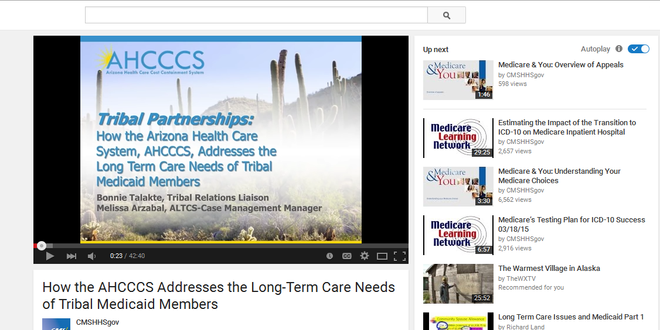
Join Monthly Webinars
Subject matter experts
Experiences from other tribes
Beginning to advanced topics
Ask questions, talk with your peers
Join live online or watch recordings later

Slide 33
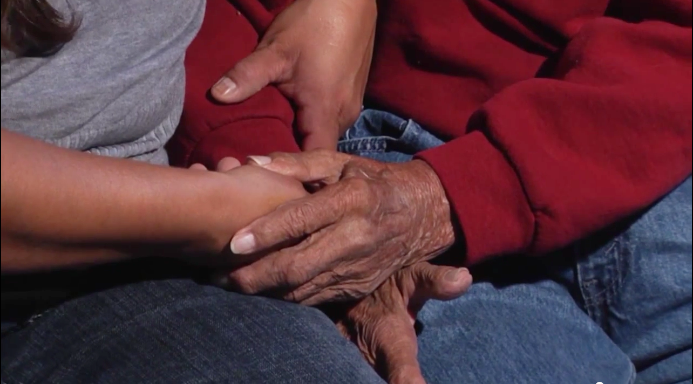
“The greatest need that we have met was the fact that [our elders] could see their family, they could see the desert, they could eat their own food, tribal food, and they could hear their own language—because that was not happening when they were off-reservation.”
—Frances Stout, Chairperson, Tohono O’odham
Nursing Care Authority, Tohono O’odham Nation
Notes:
The greatest need that we have met was just the fact that they could see their family, that they could see the desert, that they could eat their own food, tribal food, that they could hear their own language—because that was what was not happening when they were off-reservation. —Frances Stout, Chairperson, Tohono O’odham Nursing Care Authority, Tohono O’odham Nation

Slide 34
Contact
CMS Tribal Affairs Group
Email: TribalAffairs@cms.hhs.gov
LTSS Technical Assistance Center
Website: http://go.cms.gov/aian-ltss

